Slide 1
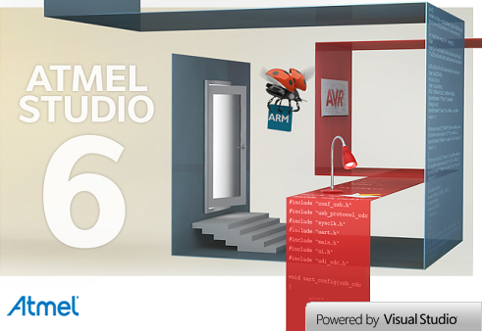
ATMEL Studio
WM SerieS
Gerson Fernando Budke
nandojve@gmail.com

Slide 2
Agenda
Overview
Installing Tools
Setup Environment
Create a Project and convert to multi target
Parametric Makefile
Blink a LED from scratch
Upload firmware with AVRxPROG
Upload firmware with SAM-BA
Issues?

Slide 3
Overview
Overview
Installing Tools
Setup Environment
Create a Project and convert to multi target
Parametric makefiles
Issues?

Slide 4
Installing tools
Install ATMEL Studio 6
  go to http://www.atmel.com/tools/atmelstudio.aspx and download a full version of ATMEL Studio 6 (with .NET)
  Now, the basic environment have ALL devices configurations.
Install SAM-BA In System Programmer (ISP)
  go to http://www.atmel.com/tools/ATMELSAM-BAIN-SYSTEMPROGRAMMER.aspx and download last version
  Download the last patch at same page
  Now, any SAM ARM processor can be upload

Slide 5
Installing tools
Install AVRxPROG
  go to https://github.com/nandojve/AVRxPROG and download last version of AVRxPROG.
  Now, the firmware can be download to board by console or any high level application. Look the basic steps at:
    cd <avrxprog install dir>
    avrxprog <enter>
Download Hercules Utility
  go to http://www.hw-group.com/products/hercules/index_en.html and download last version
  First run, accept license
Install board drivers
  go to https://github.com/nandojve/hardware
  Open <board>/driver folder and download content
  WM-100-DUINO:
    Board: WM – Wireless Modules
    Driver: WM Series (Wireless Module CDC Driver)

Slide 6
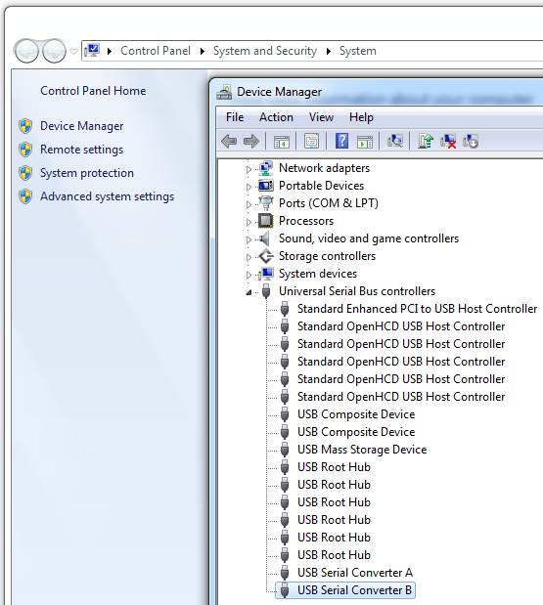
Setup Environment
Setup second KITRFA1 COM port
  Open Control Panel ->
  System and Security ->
  System ->
  USB controllers ->
  Select USB Serial Converter B ->
  Properties

Slide 7
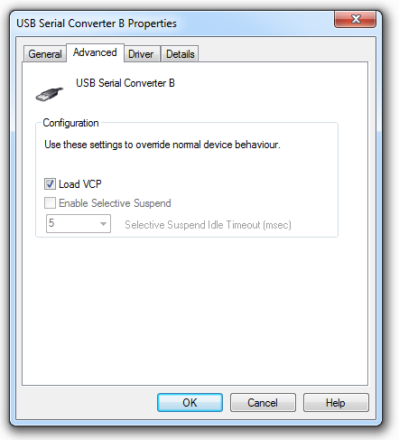
Setup Environment
  Load VCP driver
  Press OK
  Now, 2° port will install and show up

Slide 8
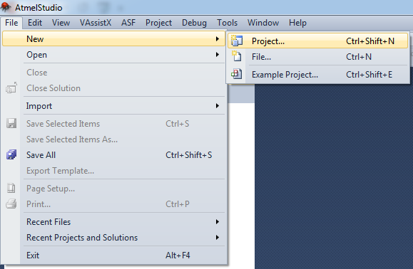
Create a Project and convert to multi target
File ->
New ->
Project

Slide 9
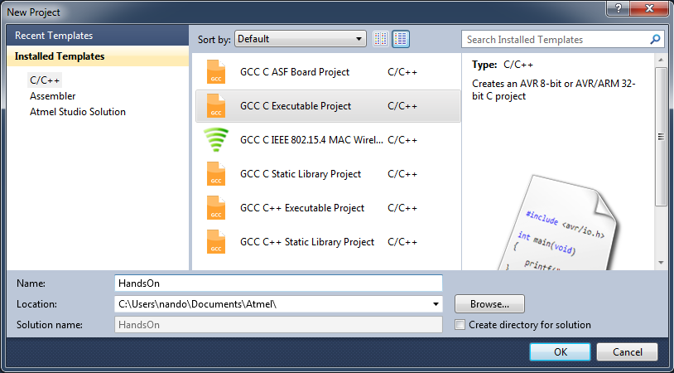
Create solution base Project
Create a GCC C Project
Set Location to your preferred base directory
Set project name to HandsOn
Note: Do not create directory for solution

Slide 10
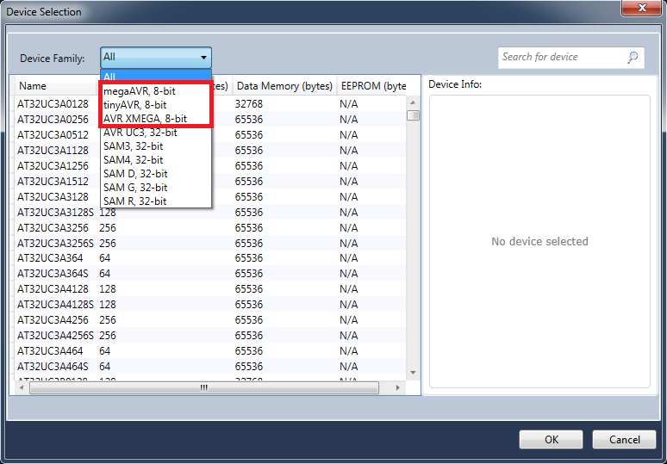
Seletct AVR8 microcontroller
Select any AVR8 microcontroller
For specific use with WM Series:
  mega128rfa1
  mega256rfr2
  xmega256a3u

Slide 11
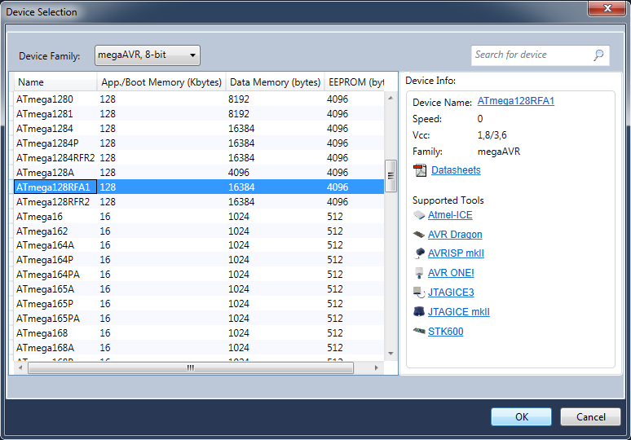
Seletct AVR8 microcontroller
This Hands On will use mega128rfa1 to support KITRFA1 & WM-100-DUINO
Now, you have a Solution

Slide 12
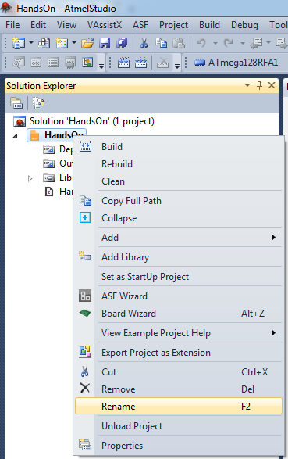
Rename avr8 Project
Rename is necessary to distinguish between AVR8 and Cortex-M projects
Rename from HandsOn to HandsOn_AVR
Now, you have a solution called HandsOn and a project called HandsOn_AVR

Slide 13
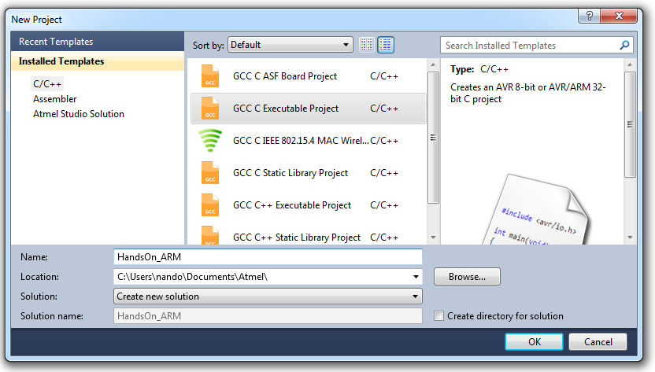
Create ARM Project
Follow the same steps to create a project
Set application name to HandsOn_ARM
Set Solution to Create new Solution
Press OK and close solution
Select Cortex-M microcontroller model ATSAM4LC4B
Now, you have a ARM Project to be added in Solution HandsOn

Slide 14
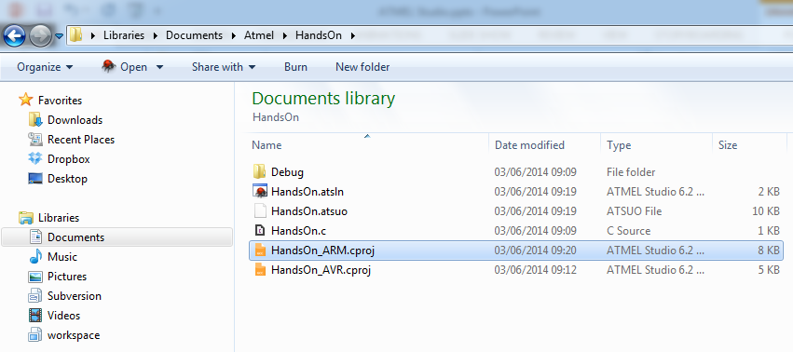
COPY arm project
Go to your project location
Look, you have two solutions
Copy from solution HandsOn_ARM the project named HandsOn_ARM.cproj to solution HandsOn

Slide 15
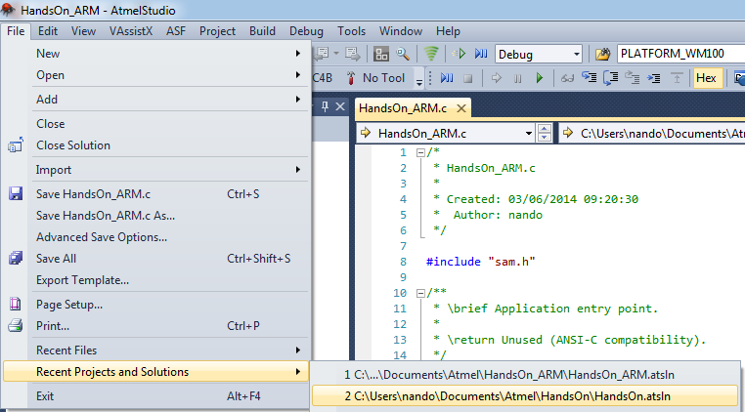
Re open hands on solution
This is need to create a multi target solution

Slide 16
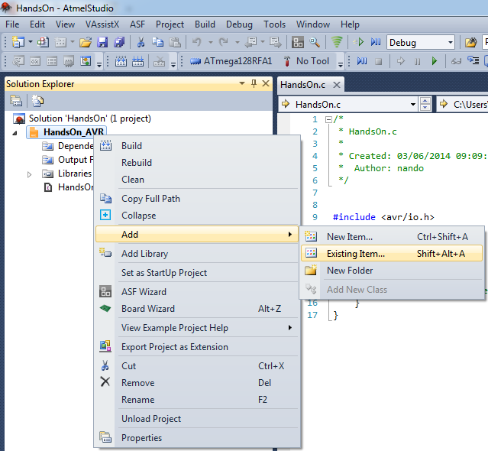
Create multi target
Add HandsOn_ARM project to your HandsOn Solution

Slide 17
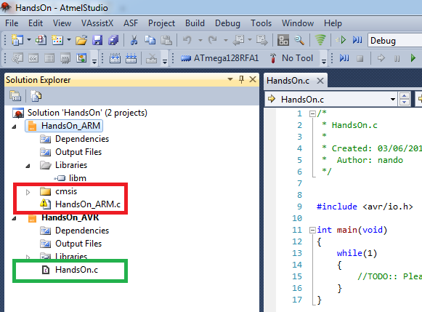
Create multi target
Add HandsOn_ARM project to your HandsOn Solution
Remove cmsis folder and HandsOn_ARM.c file from HandsOn_ARM project and select delete option
Add HandsOn.c file to HandsOn_ARM project

Slide 18
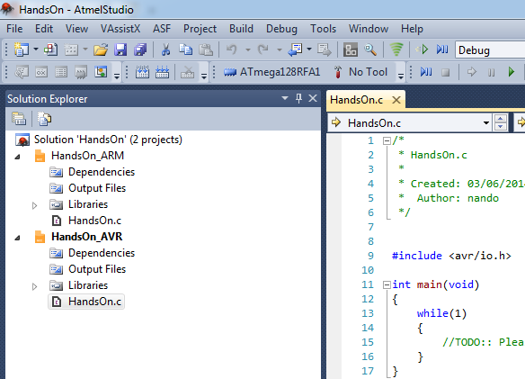
Create multi target
Now, you have a Solution called HandsOn and two projects HandsOn_AVR & HandsOn_ARM
Any changes in the HandsOn.c file will reflect in both projects

Slide 19
Parametric Makefile
Makefile is very known. Any GCC programmer known about that.
The Atmel Studio by default uses IDE environment to compile and debug. So, no makefile by default.
Aiming to improve and gain speed development WM Series uses Atmel Software Framework – ASF with Makefiles.
Makefile files were written with the intention of using build parameters. This allow create a parametric makefile to be used in project definition

Slide 20
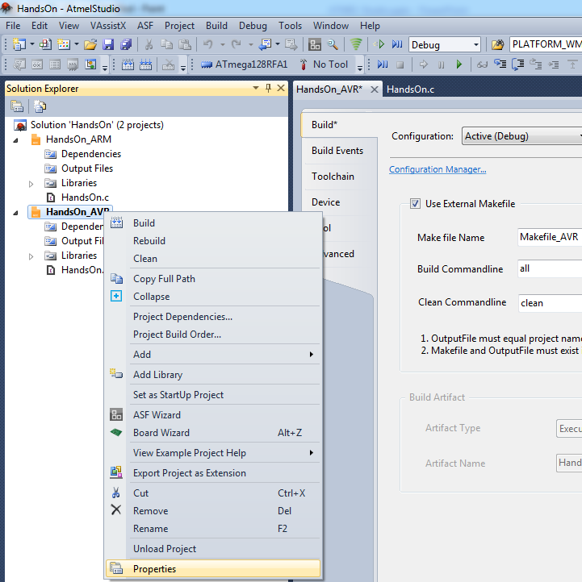
Parametric Makefile
First, you must change project build configuration
Select Use External Makefile
Set Makefile Name to Makefile_AVR
Save & close project options
Repeat this step in HandsOn_ARM project and set Makefile Name to Makefile_ARM
Copy any makefile_<target> from another sample project and add to both projects

Slide 21
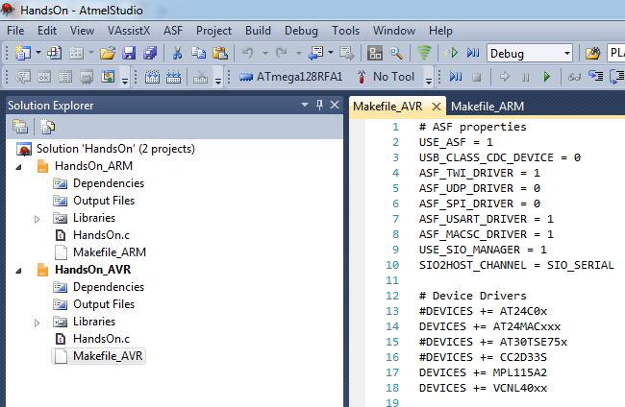
Parametric Makefile
Now, you have configured a multi target solution

Slide 22
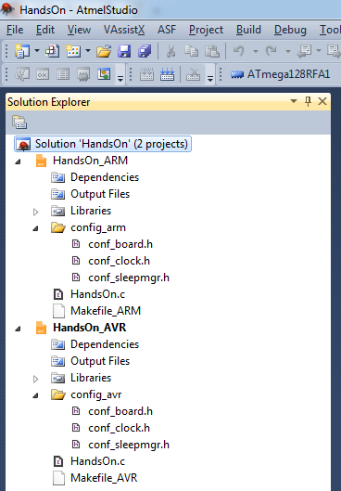
Blink a LED from scratch
To compile work, the project must have all ASF conf file
The minimal necessary files are:
  conf_board.h
  conf_sysclk.h
  conf_sleepmgr.h
Create a folder called config_<target>
Copy the samples files to each specific folder and add to correct project

Slide 23
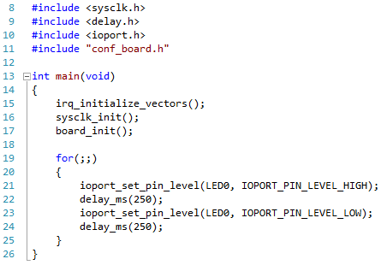
Blink a LED from scratch
Write Blink a led application
To compile code:
  Select AVR project & click build
  Select ARM project & click build
Note: F7 will build only the Start Up Project
  The Start Up Project is in BOLD

Slide 24
Upload firmware with AVRxPROG
  KITRFA1:
    Power Off kit
    Press SWITCH key
    Power On kit
    LED 3 blink 5 times
    (auto) Kit waiting AVRxPROG
    (auto) AVRxPROG will program KIT (next slide)
    (auto) AVRxPROG send exit from bootloader
    (auto) Led blink 5 times
    (auto) bootloader run application
  WM-100-DUINO
    Press Reset key (S1)
    Press DFU key (S2)
    Release S1
    LED 0 blink 5 times
    Release S2
    (auto) idem KITRFA1

Slide 25
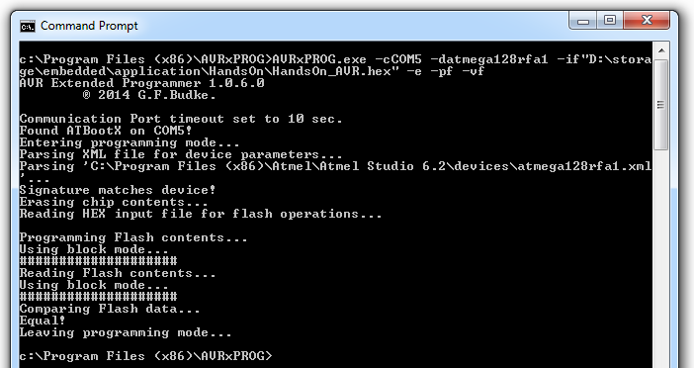
Upload firmware with AVRxPROG
Command line:
  Open command shell
  Go to <avrxprog install dir>
  and execute:
avrxprog –cCOMx
-datmega128rfa1
-if“<solution dir>\HandsOn_AVR.hex“
-e -pf –vf

Slide 26
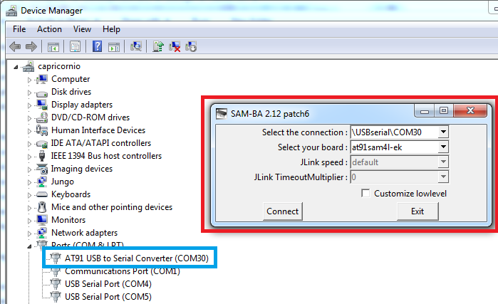
Upload firmware with SAM-BA
WM-400 Beagle Bone Shield:
  Power Off kit removing USB cable from PC
  Press DFU key
  Power On kit putting USB cable to PC. SAM-BA bootloader create a Virtual COM CDC Port in PC
  Open SAM-BA ISP software
Note: SAM-BA driver stay in <samba inst. dir.>/drv

Slide 27
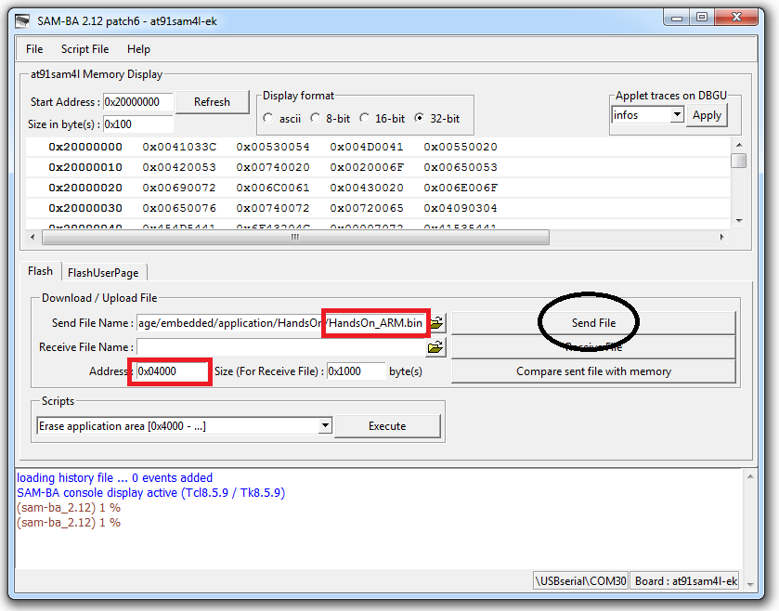
Upload firmware with SAM-BA
After SAM-BA ISP IDE open you must set application start Address to 0x4000h. The bootloader firmware reside in application flash. So application address from 0x0000h to 0x3FFFh is reserved and must be skipped when programming the board.
Select HandsOn_ARM.bin and send the program.
Close SAM-BA IDE and do a Power Off/On by USB cable
Note: do not press DFU switch because its select bootloader and application will not run

Slide 28
Issues?
nandojve at gmail dot com

